Slide 1

Mental Health Analysis in Tech Industry
-by Jujare Manasa

Slide 2

Project Summary
Mental health greatly influences employee productivity, engagement, and retention.
The tech industry faces challenges like burnout, isolation, and high stress despite its growth.
Many organizations lack consistent and effective mental health support programs.
Data analysis can uncover gaps and provide insights to improve workplace well-being.

Slide 3
Origin & Proposal
Now Maintained by
Proposed by
Initial Release
MySQL Aktiebolag
23 October 2005
Oracle Corporation

Slide 4
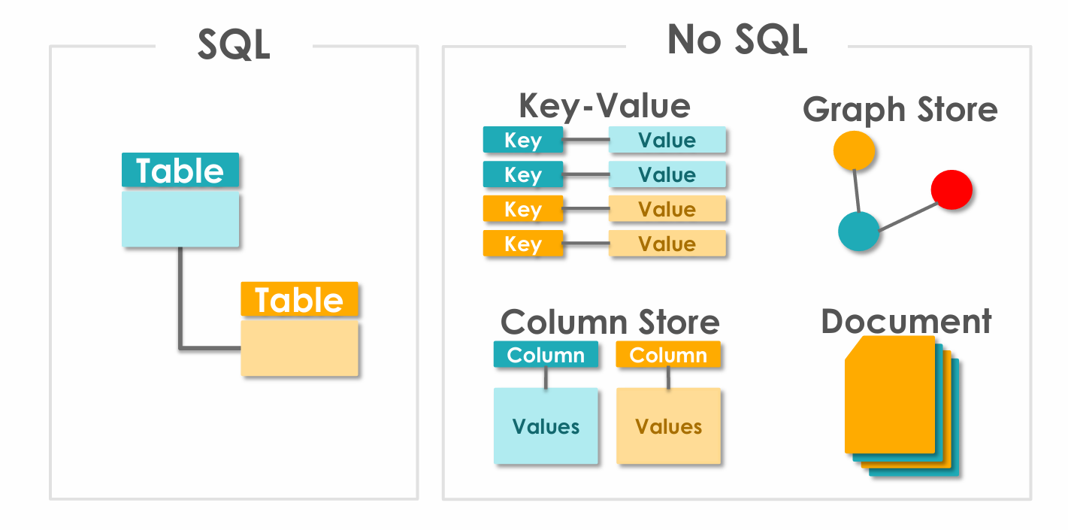

Slide 5
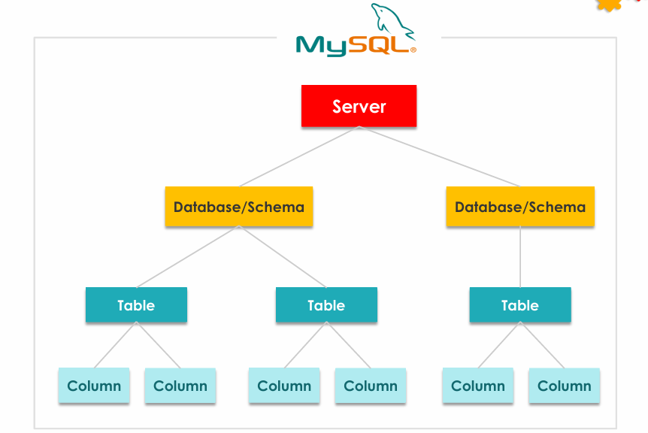

Slide 6
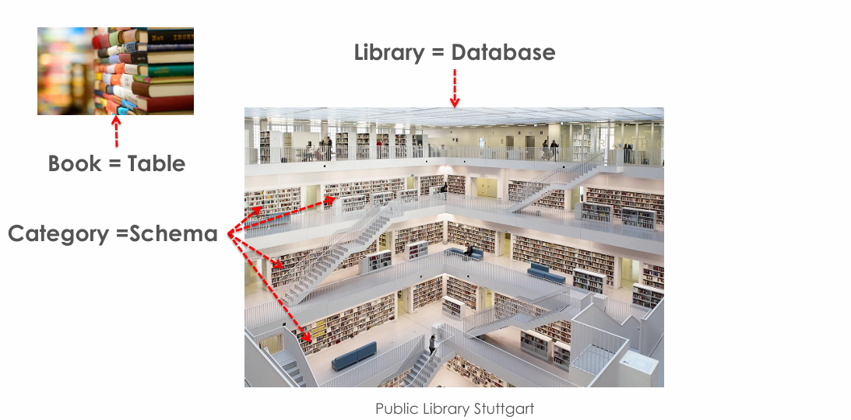

Slide 7
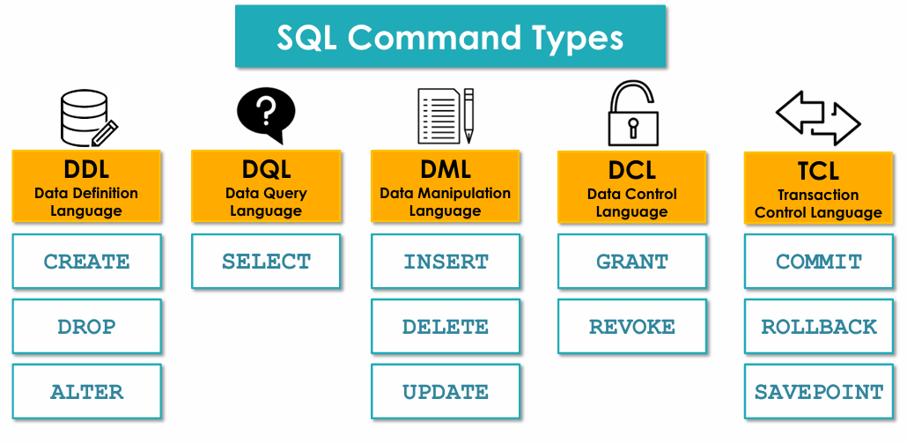

Slide 8
Project Methodology
Data Collection – Gathered employee mental health survey data and company program details.
Database Design – Created normalized relational tables in MySQL (employee responses, company details, mental health programs, manager training).
Data Processing – Inserted and cleaned records to ensure accuracy and consistency.
Data Analysis – Used SQL queries to identify patterns, trends, and gaps in mental health support.
Insights & Reporting – Generated actionable findings for improving workplace mental health initiatives.

Slide 9

Database Tables Overview
Table Name | Content Summary
company_info | Stores details about each company including ID, name, job title, industry type (Tech/Non-Tech), and region.
emp_response | Contains employee demographic data, company association, and mental health history.
mh_programs | Records company mental health program availability and quality of resources provided.
mgr_training | Tracks whether company managers have been trained in mental health awareness and follow-up support availability.
remote_status | Captures remote work status, feelings of isolation, and self-reported productivity levels of employees.
support_access | Logs employees’ perceived support, awareness of available resources, and comfort level discussing mental health.

Slide 10
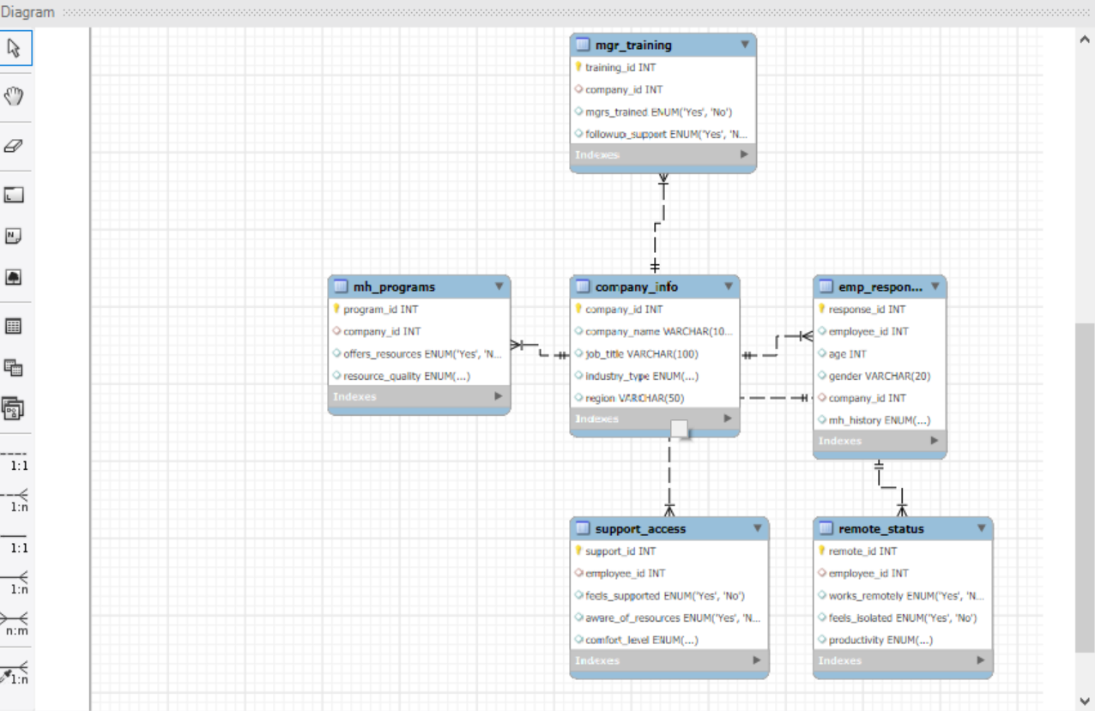
Entity Relationship Diagram

Slide 11
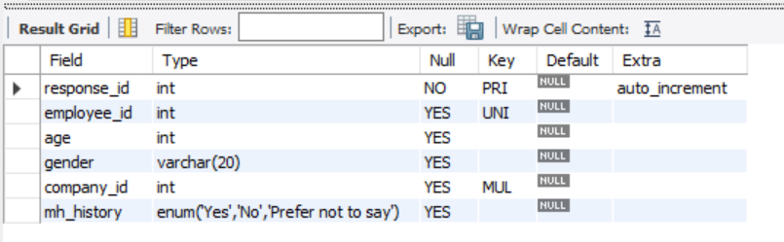
1. Creating company_info table
CREATE TABLE emp_response (
response_id INT PRIMARY KEY AUTO_INCREMENT,
employee_id INT,
age INT,
gender VARCHAR(20),
company_id INT,
mh_history ENUM('Yes', 'No', 'Prefer not to say'),
FOREIGN KEY (company_id) REFERENCES company_info(company_id));
desc emp_response;

Slide 12
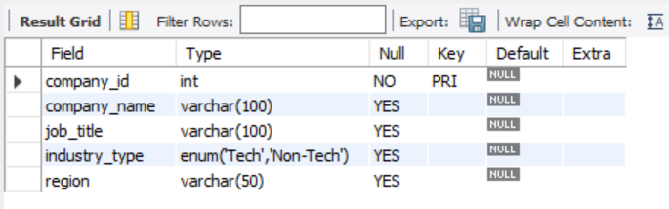
2. Creating company_info table
desc company_info;
CREATE TABLE company_info (
company_id INT PRIMARY KEY,
company_name VARCHAR(100),
job_title VARCHAR(100),
industry_type ENUM('Tech', 'Non-Tech'),
region VARCHAR(50));

Slide 13
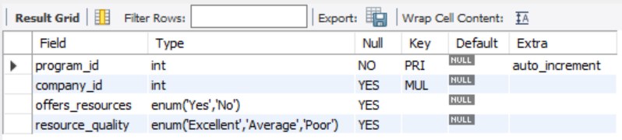
3. Creating mh_programs table
CREATE TABLE mh_programs (
program_id INT PRIMARY KEY AUTO_INCREMENT, company_id INT,
offers_resources ENUM('Yes', 'No'),
resource_quality ENUM('Excellent', 'Average', 'Poor'), FOREIGN KEY (company_id) REFERENCES company_info(company_id));
desc mh_programs;

Slide 14
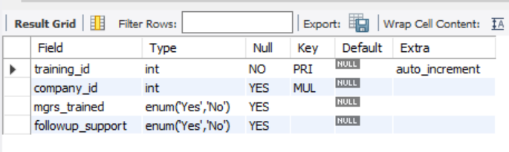
4. Creating mgr_training table
CREATE TABLE mgr_training (
training_id INT PRIMARY KEY AUTO_INCREMENT,
company_id INT,
mgrs_trained ENUM('Yes', 'No'),
followup_support ENUM('Yes', 'No'),
FOREIGN KEY (company_id) REFERENCES company_info(company_id));
desc mgr_training;

Slide 15
5. Creating remote_status table
CREATE TABLE remote_status (
remote_id INT PRIMARY KEY AUTO_INCREMENT,
employee_id INT,
works_remotely ENUM('Yes', 'No'),
feels_isolated ENUM('Yes', 'No'),
productivity ENUM('High', 'Moderate', 'Low'),
FOREIGN KEY (employee_id) REFERENCES emp_response(employee_id));
desc remote_status;

Slide 16
6. Creating support_access table
CREATE TABLE support_access (
support_id INT PRIMARY KEY AUTO_INCREMENT,
employee_id INT,
feels_supported ENUM('Yes', 'No'),
aware_of_resources ENUM('Yes', 'No'),
comfort_level ENUM('High', 'Medium', 'Low'),
FOREIGN KEY (employee_id) REFERENCES emp_response(employee_id));
desc support_access;

Slide 17
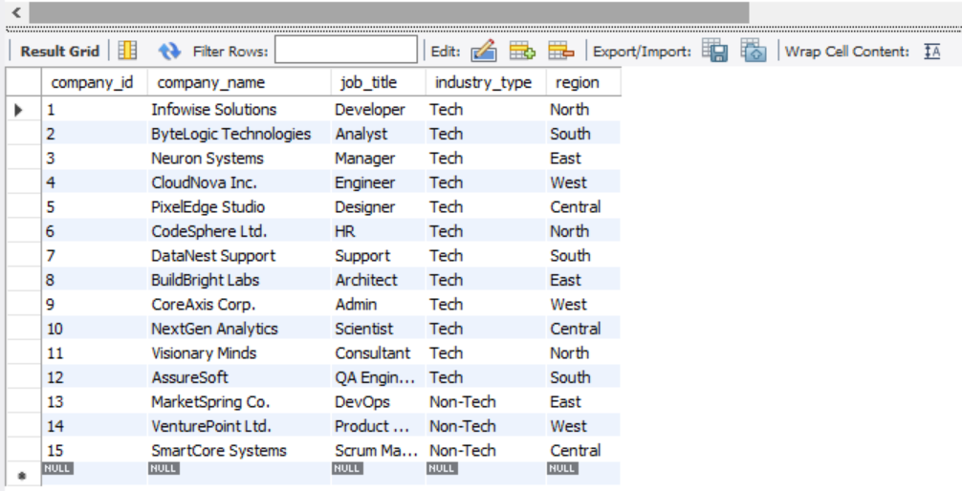
7. View all company_info records
-- Retrieving all columns
SELECT * FROM company_info;

Slide 18
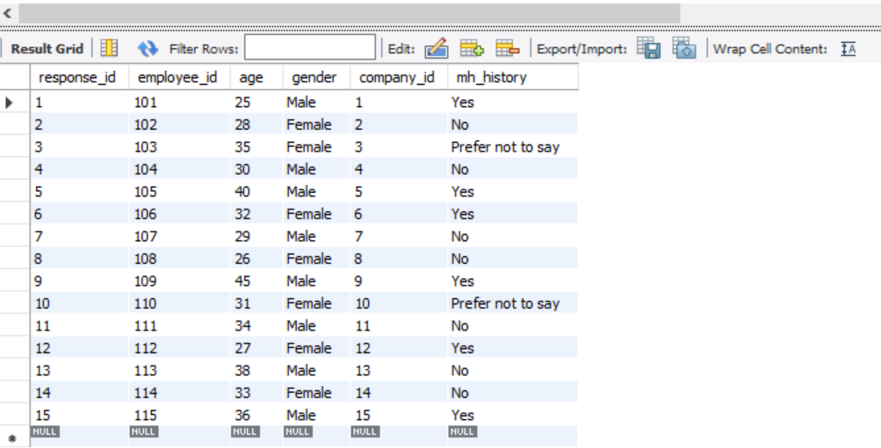
8. View emp_response records
-- Retrieving all columns
SELECT * FROM emp_response;

Slide 19
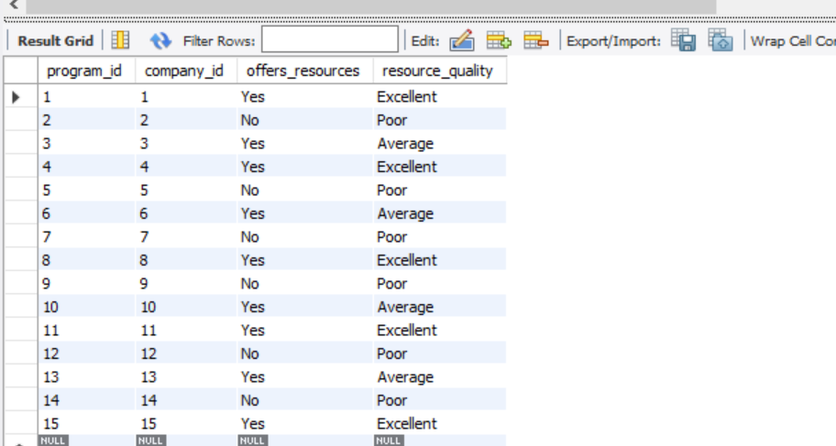
9. View mh_programs records
-- Retrieving all columns
SELECT * FROM mh_programs;

Slide 20
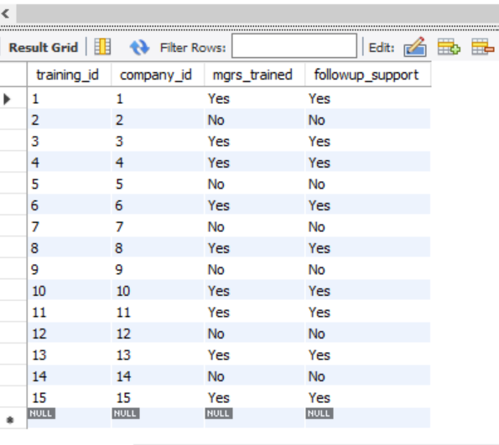
10. View mgr_training records
SELECT * FROM mgr_training;

Slide 21
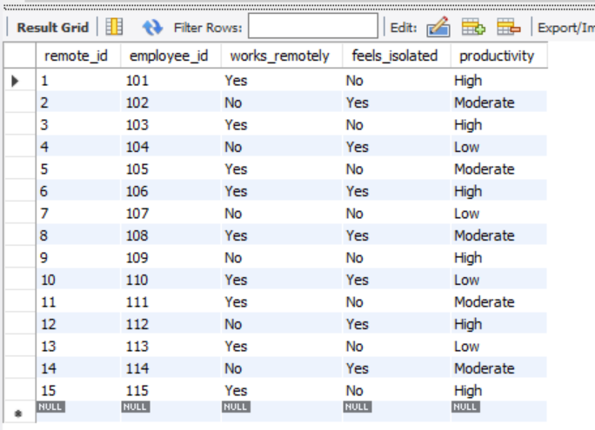
11. View remote_status records
SELECT * FROM remote_status;

Slide 22
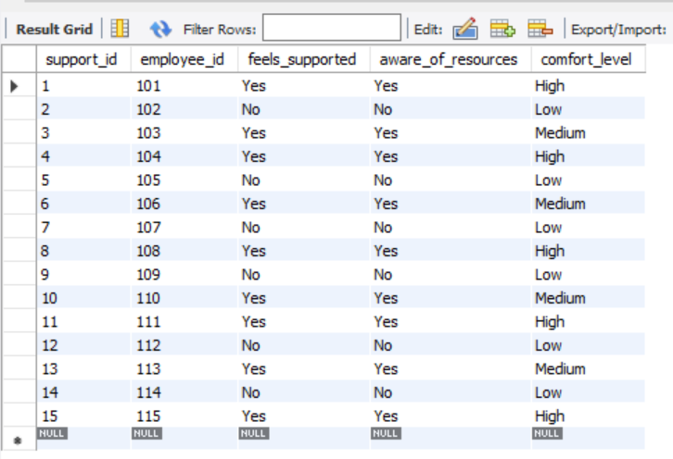
12. View support_access records
SELECT * FROM support_access;

Slide 23
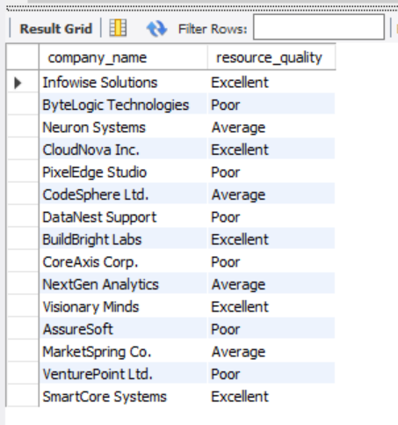
13. Identify companies that offer mental health programs and assess their quality
SELECT ci.company_name, mp.resource_quality
FROM company_info ci JOIN mh_programs mp
ON ci.company_id = mp.company_id;

Slide 24
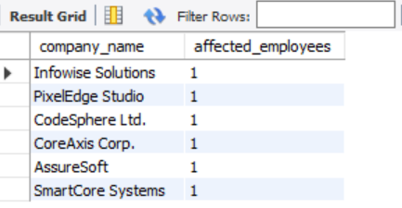
14. Count employees with a history of mental health issues per company.
SELECT ci.company_name, COUNT (er.response_id) AS affected_employees
FROM emp_response er JOIN company_info ci
ON er.company_id = ci.company_id
WHERE er.mh_history = 'Yes‘
GROUP BY ci.company_name;

Slide 25
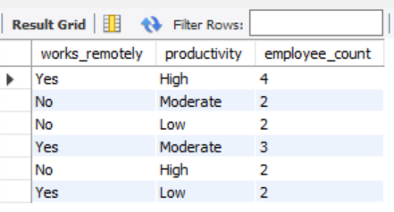
15. List remote employees who also feel isolated
SELECT employee_id, works_remotely, feels_isolated
FROM remote_status
where works_remotely = 'yes'
AND feels_isolated = 'yes';

Slide 26
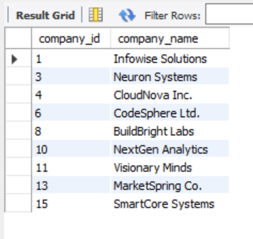
16. Companies with managers trained in mental health awareness
SELECT ci.company_id, ci.company_name FROM company_info ci JOIN mgr_training mt
ON ci.company_id = mt.company_id
where mt.mgrs_trained = 'yes';

Slide 27
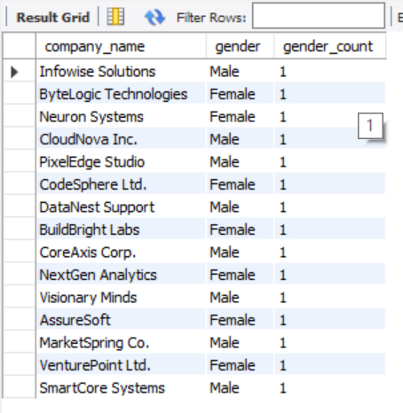
17. Employee gender distribution by company
SELECT ci.company_name, er.gender, COUNT(*) AS gender_count
FROM emp_response er JOIN company_info ci
ON er.company_id = ci.company_id
GROUP BY ci.company_name, er.gender;

Slide 28
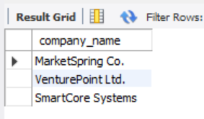
18. List of non-tech companies with no mental health programs
SELECT ci.company_name FROM company_info ci
LEFT JOIN mh_programs mp ON ci.company_id = mp.company_id
WHERE ci.industry_type = 'Non-Tech'
AND mp.program_id IS NOT NULL;

Slide 29
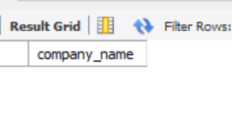
19. List of tech companies with mental health programs
SELECT ci.company_name FROM company_info ci
LEFT JOIN mh_programs mp ON ci.company_id = mp.company_id
WHERE ci.industry_type = 'Non-Tech'
AND mp.program_id IS NULL;

Slide 30
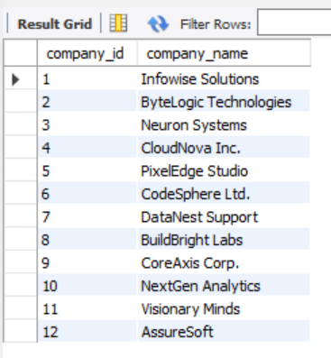
20. List of tech companies with mental no health programs
SELECT ci.company_id, ci.company_name FROM company_info ci
LEFT JOIN mh_programs mp ON ci.company_id = mp.company_id
WHERE ci.industry_type = 'Tech'
AND mp.program_id IS NOT NULL;

Slide 31
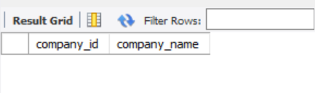
21. Employees who feel unsupported and unaware of resources
SELECT ci.company_id, ci.company_name FROM company_info ci LEFT JOIN mh_programs mp on ci.company_id = mp.company_id WHERE ci.industry_type = 'Tech'
AND mp.program_id IS NULL;

Slide 32
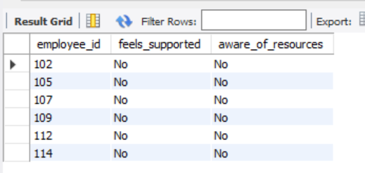
22. Companies where employees feel supported and comfortable discussing mental health
SELECT employee_id, feels_supported, aware_of_resources FROM support_access
WHERE feels_supported = 'No'
AND aware_of_resources = 'No';

Slide 33
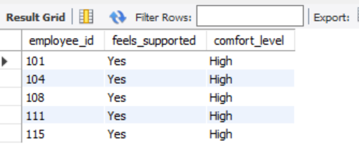
23. Employees who feel unsupported and unaware of resources
SELECT employee_id, feels_supported, comfort_level FROM support_access
WHERE feels_supported = 'Yes' AND comfort_level = 'High';

Slide 34
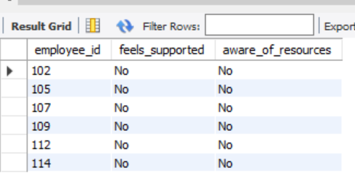
24. Companies where employees feel supported and comfortable discussing mental health
SELECT employee_id, feels_supported, aware_of_resources FROM support_access
WHERE feels_supported = 'No‘
AND aware_of_resources = 'No';

Slide 35
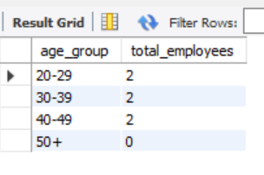
25. Age distribution of employees with mental health history
SELECT '20-29' AS age_group, COUNT(*) AS total_employees FROM emp_response
WHERE age BETWEEN 20 AND 29 AND mh_history = 'Yes‘
UNION ALL
Group 30–39SELECT '30-39', COUNT(*) FROM emp_response
WHERE age BETWEEN 30 AND 39 AND mh_history = 'Yes‘
UNION ALL
Group 40–49SELECT '40-49', COUNT(*) FROM emp_response
WHERE age BETWEEN 40 AND 49 AND mh_history = 'Yes‘
UNION ALL
Group 50+SELECT '50+', COUNT(*) FROM emp_response
WHERE age >= 50 AND mh_history = 'Yes';

Slide 36
Conclusion
The analysis revealed varying levels of mental health awareness, program quality, and managerial support across companies.
Remote work presents both productivity benefits and challenges like isolation for some employees.
Many organizations still lack structured mental health programs, particularly in certain industry segments.
By leveraging relational databases and SQL, meaningful insights can be drawn to inform HR strategies and policy improvements.
Future scope: Integration with real-time survey tools, predictive analytics, and AI-driven mental health risk assessments for proactive support.

Slide 37

Thank You

